Slide 1
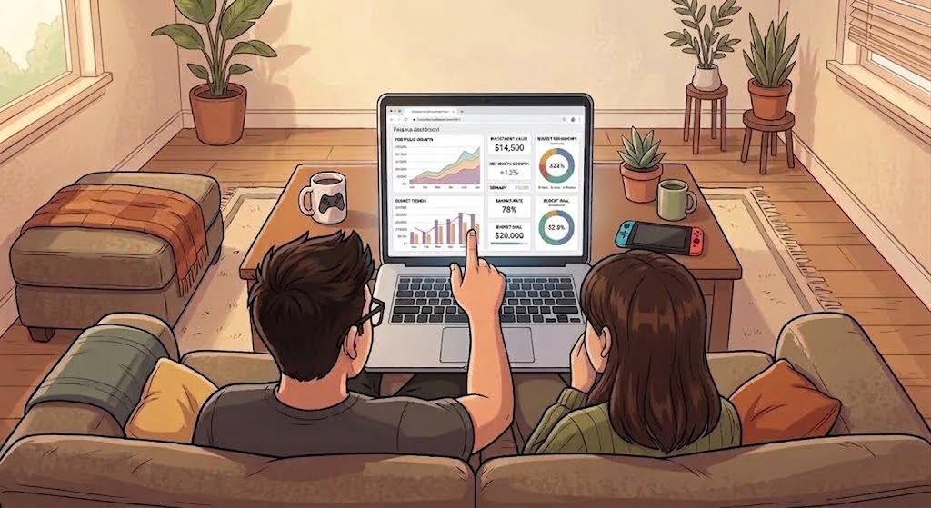
Personal Finances Project
Created by Clarissa Yamakita

Slide 2

Meet the protagonists of our story
This is Kenji, an avid gamer who also applies his problem solving skills in his role as a product manager.
And this is Mei, a sound designer who brings music into all aspects of her life.
They’re a couple in their 30s who want to make sure they’re taking the right financial decisions.
Created by Clarissa Yamakita

Slide 3
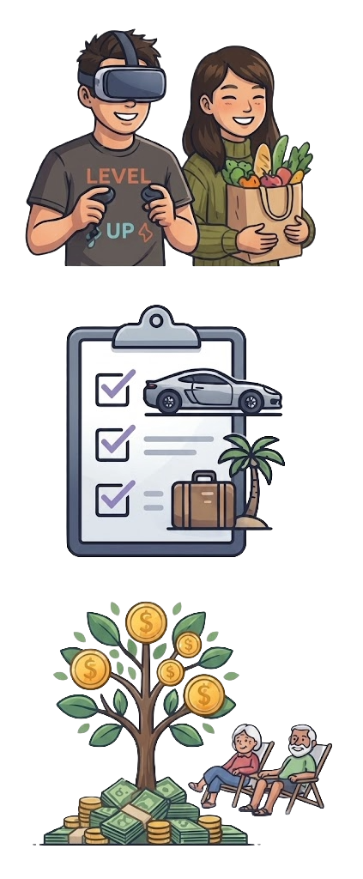
They have some objectives in mind
1. Enjoy Life
Can they afford these groceries?
Can they book a VR session this weekend?
2. Achieve Goals
Which goals are already funded?
When will they be able to buy a car?
3. Build Wealth
Will they be able to retire at 65?
What will be their income once they retire?
Created by Clarissa Yamakita

Slide 4
How to achieve them
Apply Conscious Spending Plan* framework and allocate take-home pay:
Type
Description
% Take-Home Pay
Fixed Costs
What you need to live on a month
(rent, utilities, groceries, transportation)
50 - 60%
Savings
Money you’re going to use in 1 to 5 years
(emergency fund, vacation, car)
5 - 10%
Investments
Wealth building
(TFSA, RRSP, non-registered accounts)
5 - 10%
Guilt-Free
What you love to do
(travel, eating out, clothes, hobbies)
20 - 35%
Created by Clarissa Yamakita

Slide 5
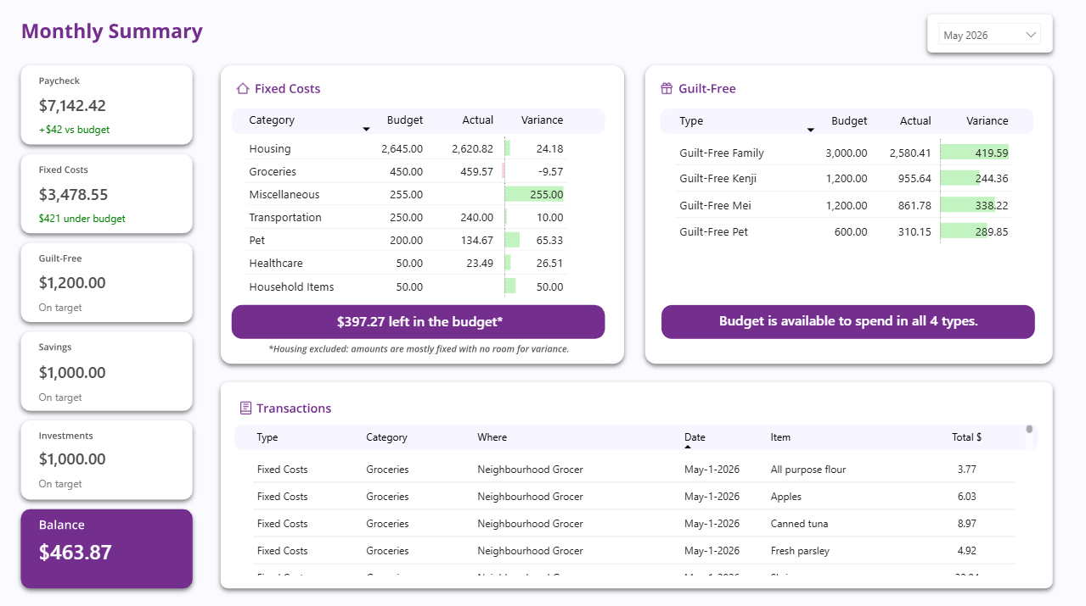
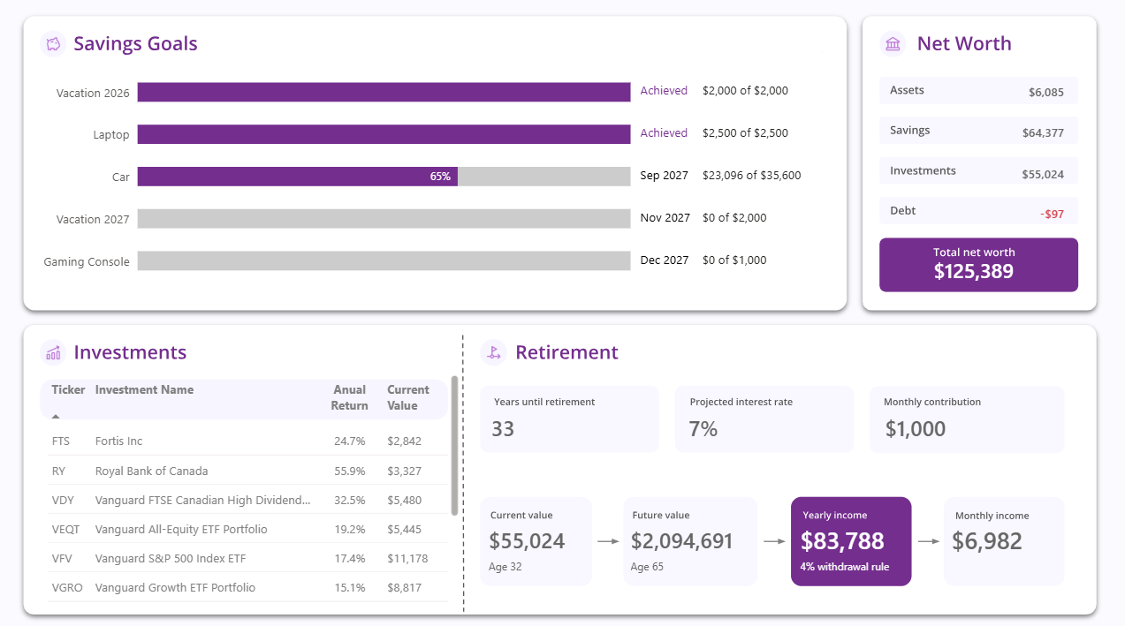
How can they make sure they’re on the right track?
Created by Clarissa Yamakita

Slide 6
They can use this part of the dashboard to …
Created by Clarissa Yamakita

Slide 7
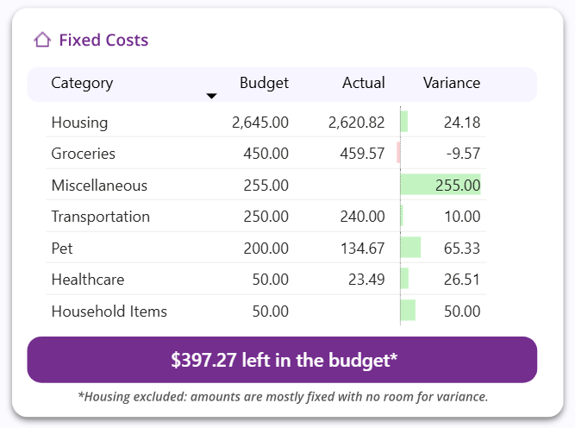

1. Enjoy Life: Can they buy these groceries?
It depends. Even though they've already gone over the Groceries budget, they still have some left from other categories, like Miscellaneous.
Specific categories could be negative as long as they compensate for each other. Overall variance should remain positive.
Created by Clarissa Yamakita

Slide 8
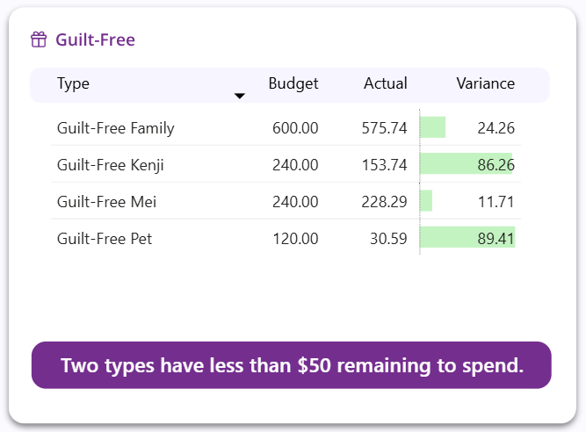

1. Enjoy Life: Can they book a VR session this weekend?
A VR gaming session for 2 people + dinner with friends could cost around $200 in total.
Kenji and Mei don’t have enough on their Guilt-Free Family budget this month.
Amounts are accumulated over time. If a certain amount isn’t used on a month, it can be carried over to the future.
Created by Clarissa Yamakita

Slide 9

And here is where they see their dreams coming true:
Created by Clarissa Yamakita

Slide 10
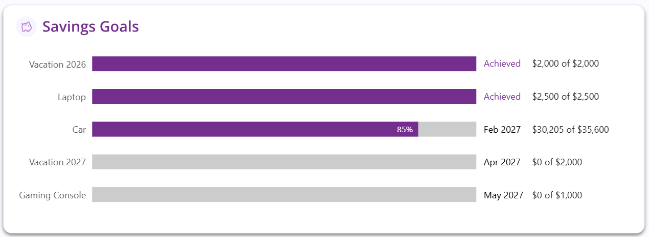
2. Achieve Goals: Which goals are already funded?
Kenji and Mei have already saved the amount needed for this year's vacation and a laptop.
Created by Clarissa Yamakita

Slide 11

2. Achieve Goals: When will they be able to buy a car?
With their current savings progress, they should be able
to buy a car by February, 2027.
Created by Clarissa Yamakita

Slide 12
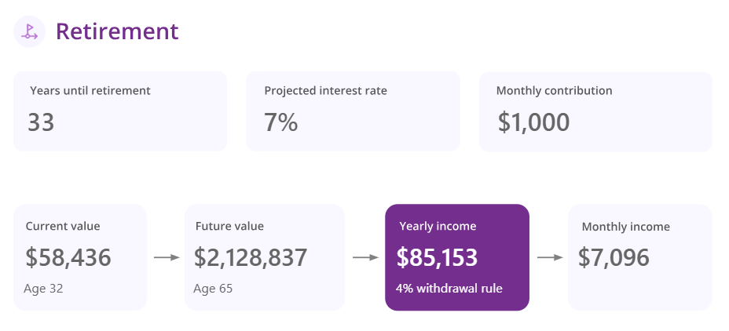
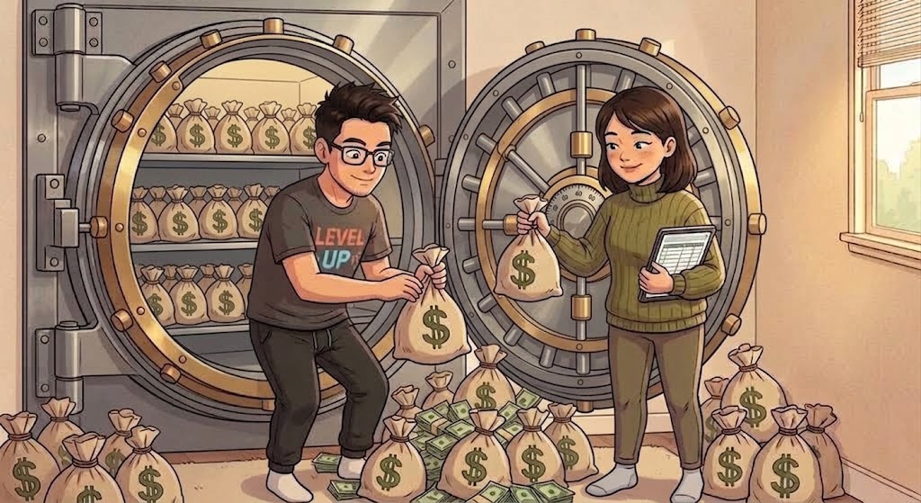
3. Build Wealth: Will they be able to retire at 65?
In 33 years, Kenji and Mei could have enough to live off only from their investments.
They would have about $2.1M considering an average interest rate of 7% and a monthly contribution of $1,000 to their current investments.
The 4% withdrawal rule says you can safely withdraw about 4% of your portfolio per year without running out of money — that's how $2.1M becomes $85,153/year.
Created by Clarissa Yamakita

Slide 13
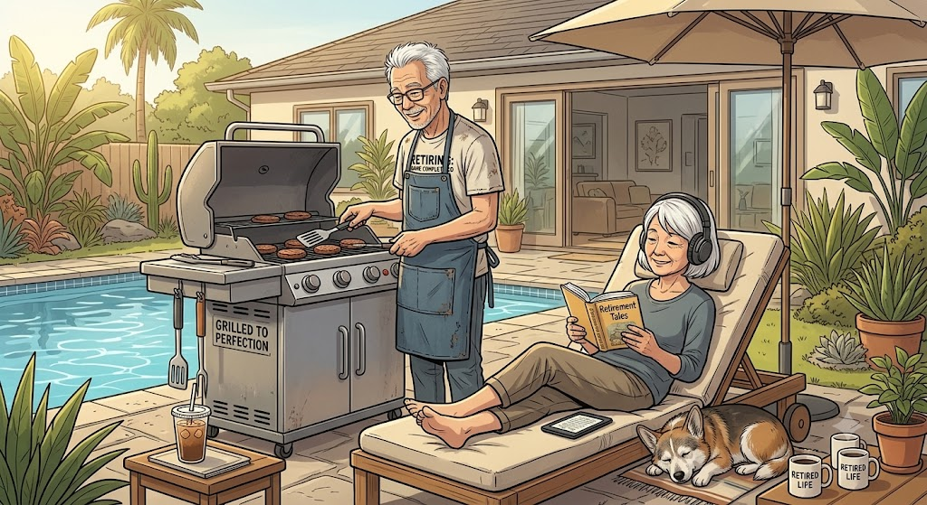
3. Build Wealth: What will be their income once they retire?
Good news: $7,096/month almost matches Kenji's and Mei’s current paycheck of $7,142 — their retirement income from investments alone could fully replace their current salaries.
Created by Clarissa Yamakita

